Slide 1
Vehicle Identification
Harsh Patel
Jill Hughes
Logan Murphy
Mihai Anghel

Slide 2
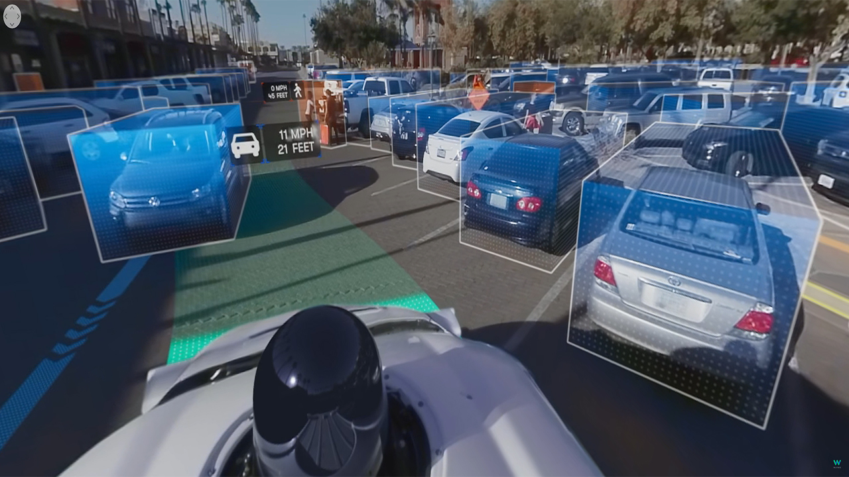
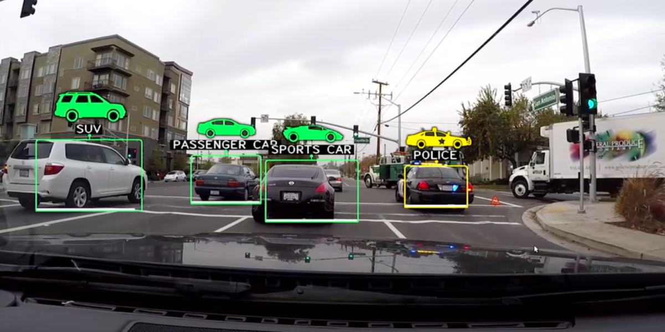
Model for Vehicle Image Recognition
Why choose this topic? Our team decided to pursue this topic for the various versatile utilizations a model such as this could have on a number of different transportation applications. Applications such as monitoring traffic flow, automated parking systems and support for traffic law enforcement could integrate this machine learning model into their product to increase efficiency and results per their requirements.
Notes:
https://content.fortune.com/wp-content/uploads/2015/10/screen-shot-2015-10-15-at-8-04-48-pm.png?resize=1200,600
https://www.altoros.com/blog/wp-content/uploads/2018/06/TensorFlow-Deep-Learning-Artificial-Intelligence-Machine-Learning-Waymo-360-sensors.jpg

Slide 3
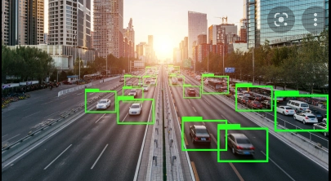
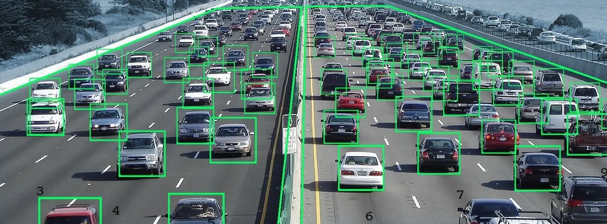
Our Data
Our data source offers 16,185 images of 196 classes of cars. These are split between 8,144 training & 8,041 testing images, each class has been roughly 50-50 split.
The classes are at the level of Make, Model, Year Ex: 2012 Tesla Model S or 2021 BMW M3 coupe
Citation: 3D Object Representations for Fine-Grained Categorization Jonathan Krause, Michael Stark, Jia Deng, Li Fei-Fei 4th IEEE Workshop on 3D Representation and Recognition, at ICCV 2013 (3dRR-13). Sydney, Australia. Dec. 8, 2013. Source: Stanford.edu ~jkrause Dataset
Notes:
https://viso.ai/wp-content/uploads/2021/05/deep-learning-vehicle-detection-video-analytics.jpg
https://venturebeat.com/2019/10/28/how-ai-is-impacting-the-automotive-world/.

Slide 4

Questions team hopes to answer (Part One)
What are the steps to prep the raw data & upload it to the database?
Conversion of MatLab metadata files into Pandas DataFrames
Adjusting DataFrames to reflect accurate data types
Creation of AWS PostgreSQL Database
Move contents from Pandas DataFrames into AWS PostgreSQL Database
Table creation & population

Slide 5
Questions team hopes to answer (Part Two)
How do we connect our data to the model?
Read in database and create dataframe
Query merging images Import dataset into model through query merging

Slide 6
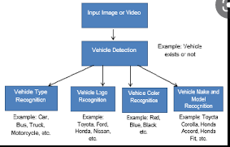
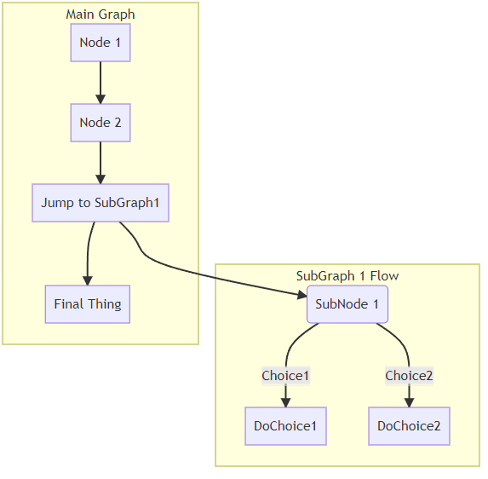
Data Exploration

Slide 7
Analysis Phase P1
Data gathering/cleaning
Raw data to Pandas dataframe, uploaded to database
Use df and/or db for modeling

Slide 8
Analysis Phase P2
Model: testing using cleaned data
-read database and create dataframe
-test model
-update test image class
-evaluate accuracy
How was data split into testing and training datasets?

Slide 9
Front End
Flask Application
-created using pickle file of model
-final deployed application will take an uploaded image and return: vehicle/ not vehicle

